Slide 1
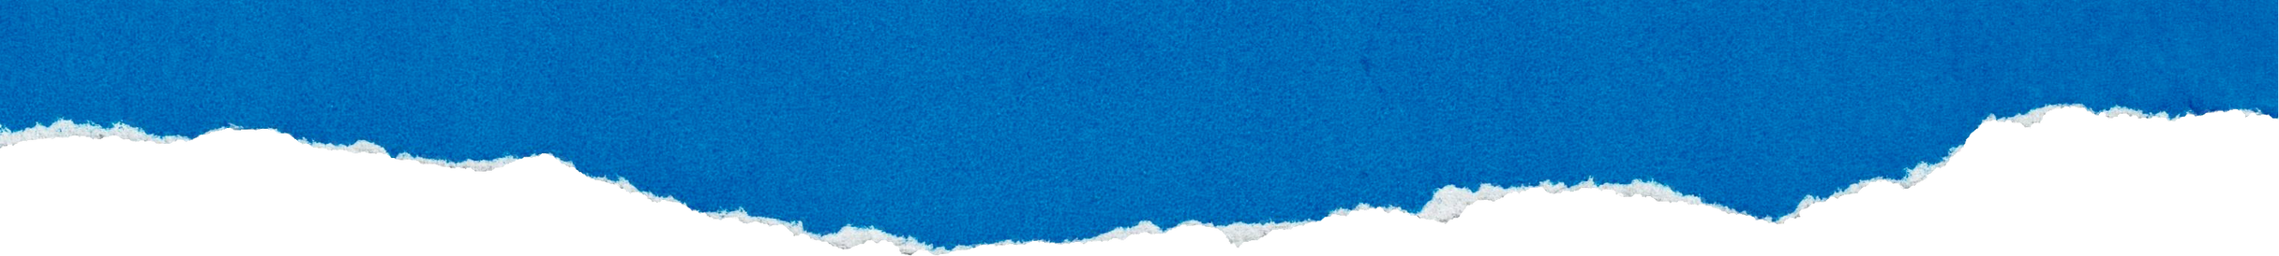



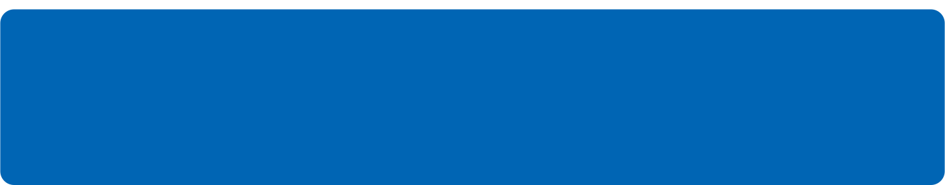
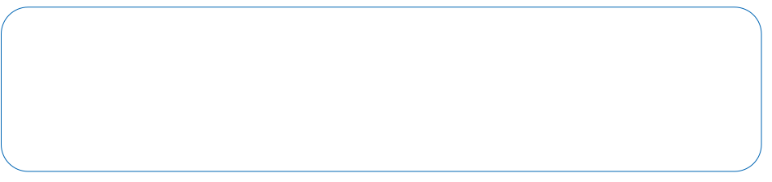
S25' Training Sessions
Mobile App
SESSION 6
#create_share_innovate

Slide 2

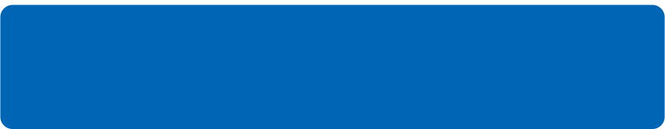
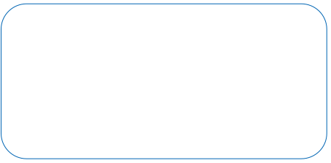
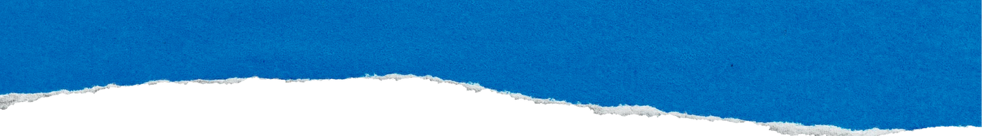
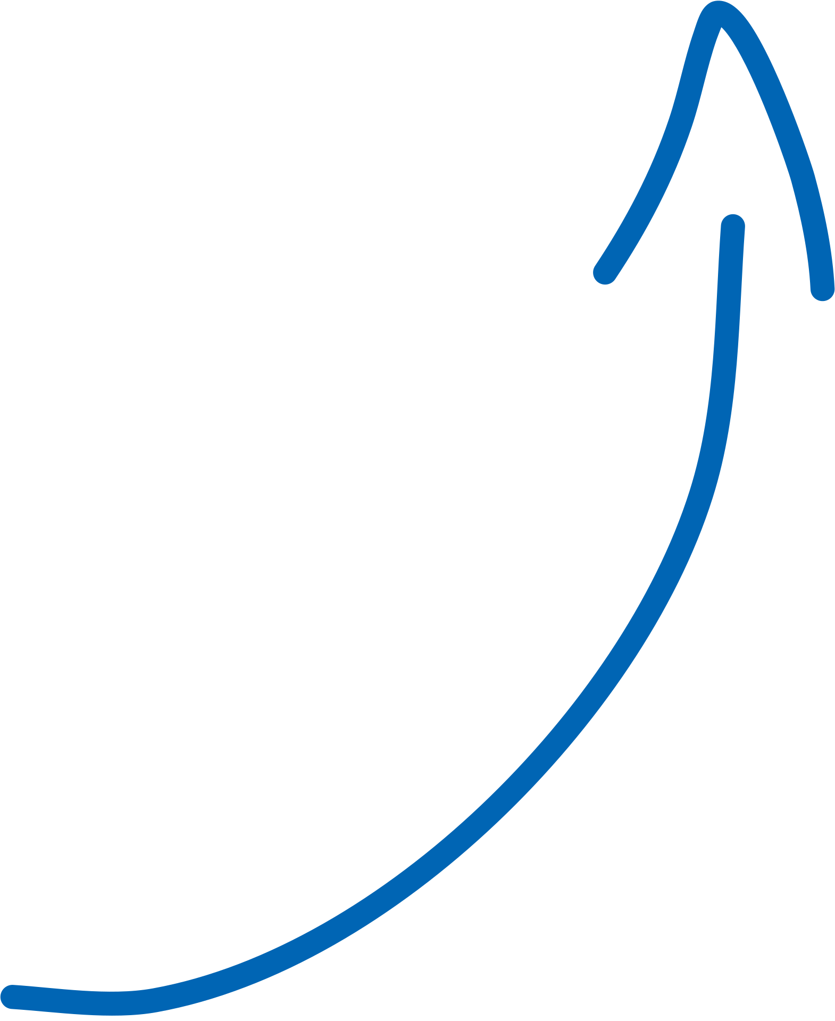

Table of contenet
Task Evaluation
Flutter Intro
Widgets Intro
S25' Training Sessions
BasicWidgets
Layout Widgets

Slide 3

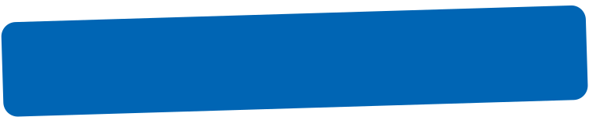
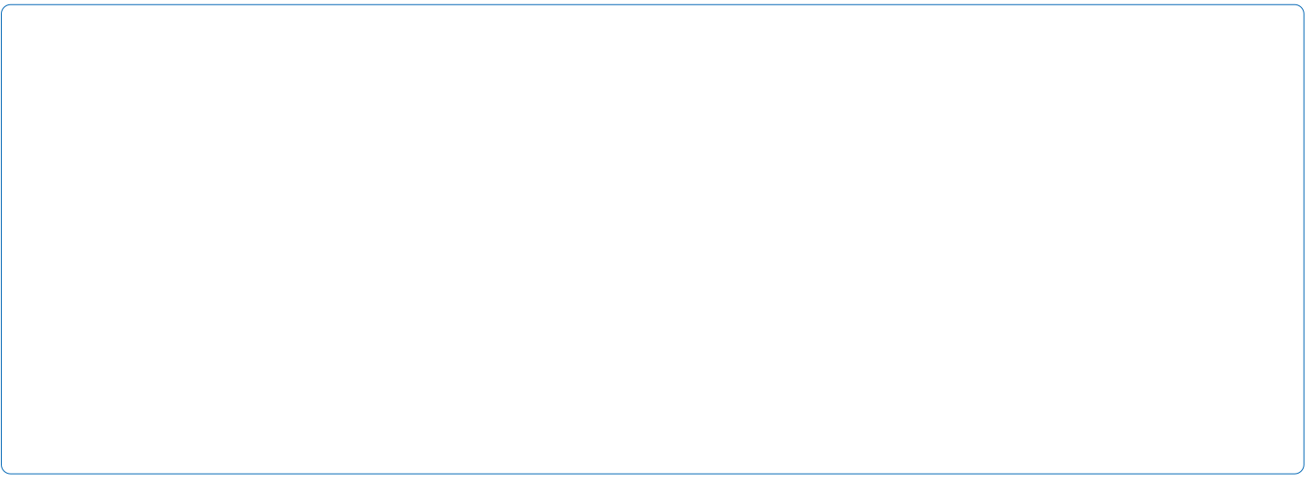
Task
S25' Training Sessions
Task Evaluation

Slide 4
Intro to Flutter
Flutter is an open-source UI toolkit created by Google for building natively compiled applications for:
Mobile (Android & iOS)
Web
Desktop
Embedded devices
...all from a single codebase.
S25' Training Sessions

Slide 5
Intro to Flutter
Why Flutter?
Fast Development : Hot Reload lets you see changes instantly.
Beautiful UIs : Comes with rich set of customizable widgets.
Single Codebase : Write once, run anywhere.
Flexible & Powerful : Easily build complex layouts.
Backed by Google : Strong community & support.
S25' Training Sessions

Slide 6
Intro to Flutter
Flutter Is Made Of:
Dart Programming Language
Flutter Engine : Handles rendering, animation, etc.
Widgets : The building blocks of UI
S25' Training Sessions

Slide 7
Task
S25' Training Sessions
Environment Setup

Slide 8
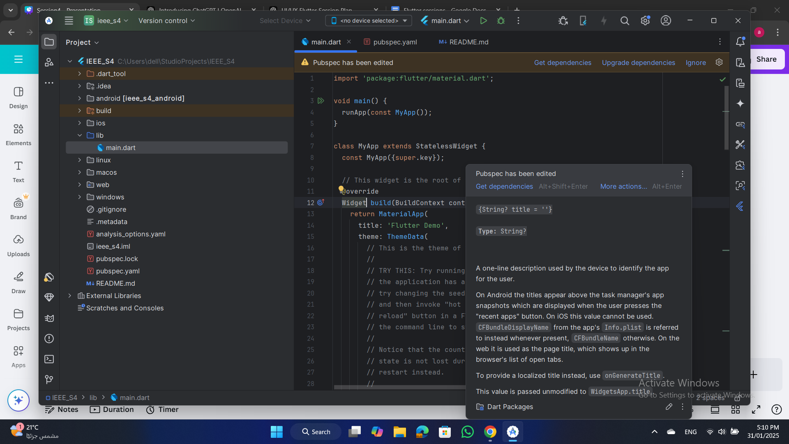
Intro to Flutter
Flutter Project:
Key Files and Folders in a Flutter Project:
S25' Training Sessions
1.lib/main.dart (The Entry Point of the App)
This file contains the main() function, which is the starting point of a Flutter app.
Inside main(), we use the runApp() function to launch the app’s UI.

Slide 9
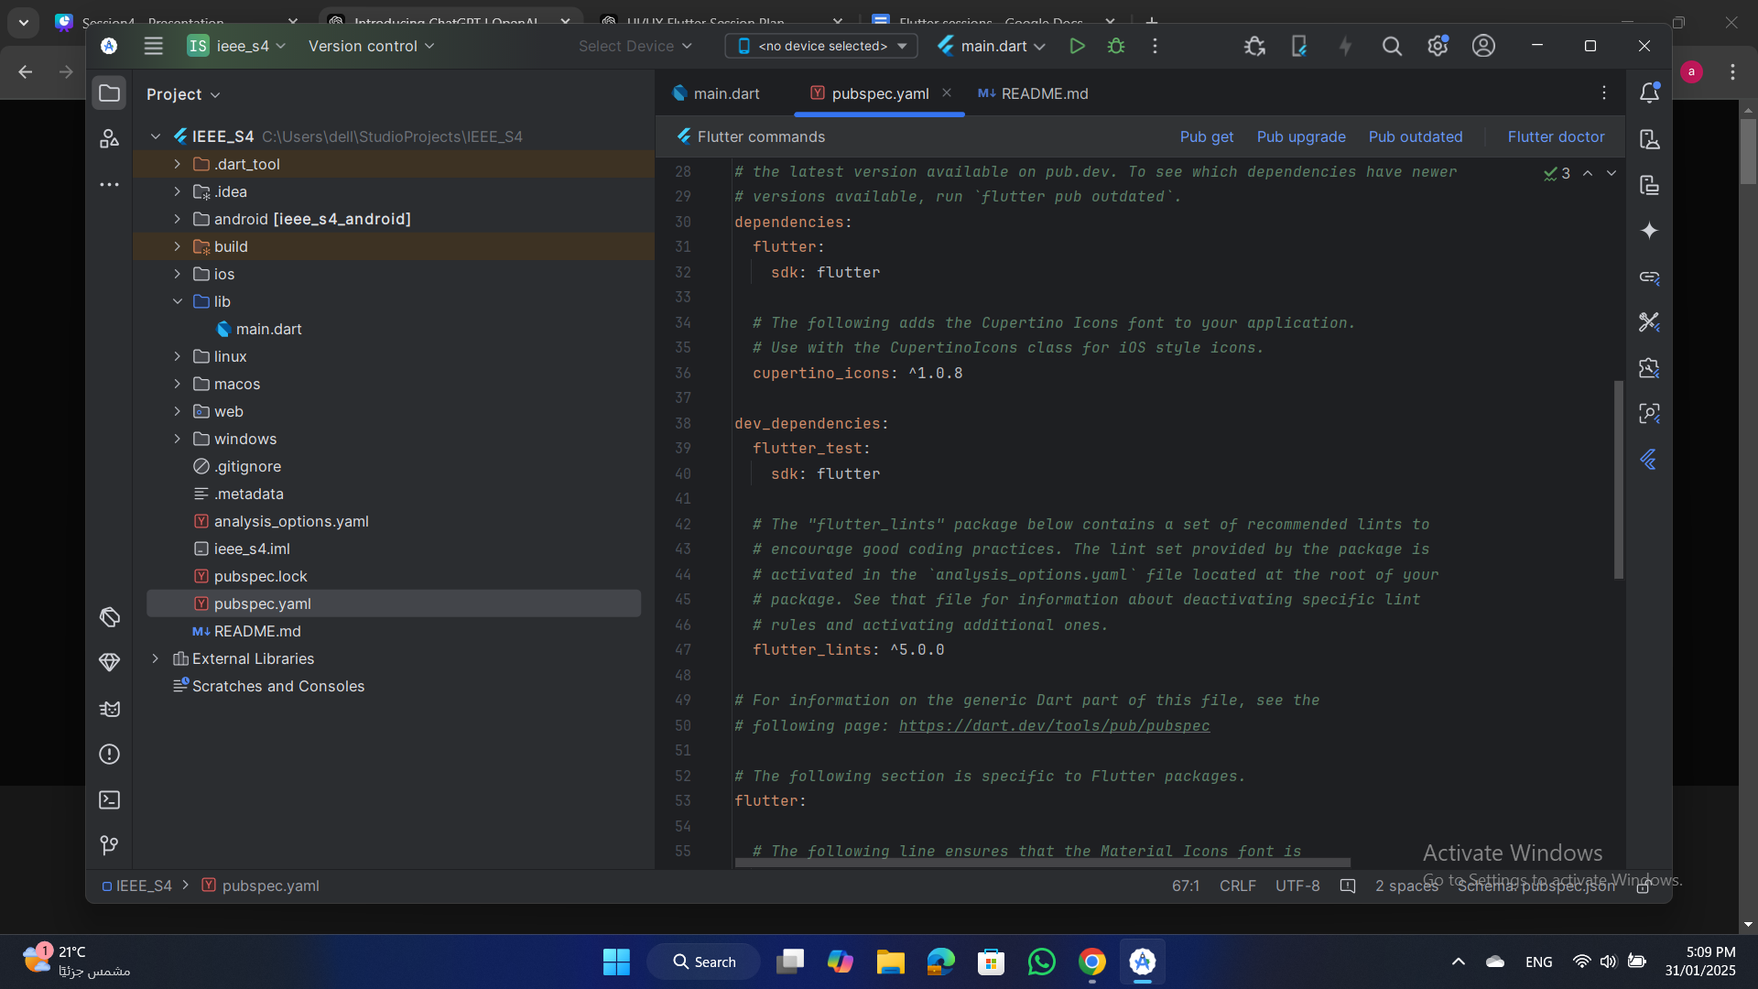
Intro to Flutter
2.pubspec.yaml (Dependency & Asset Management)
This file is used to manage:
Dependencies.
Assets (images, fonts, icons).
App metadata (like app name and version).
S25' Training Sessions

Slide 10
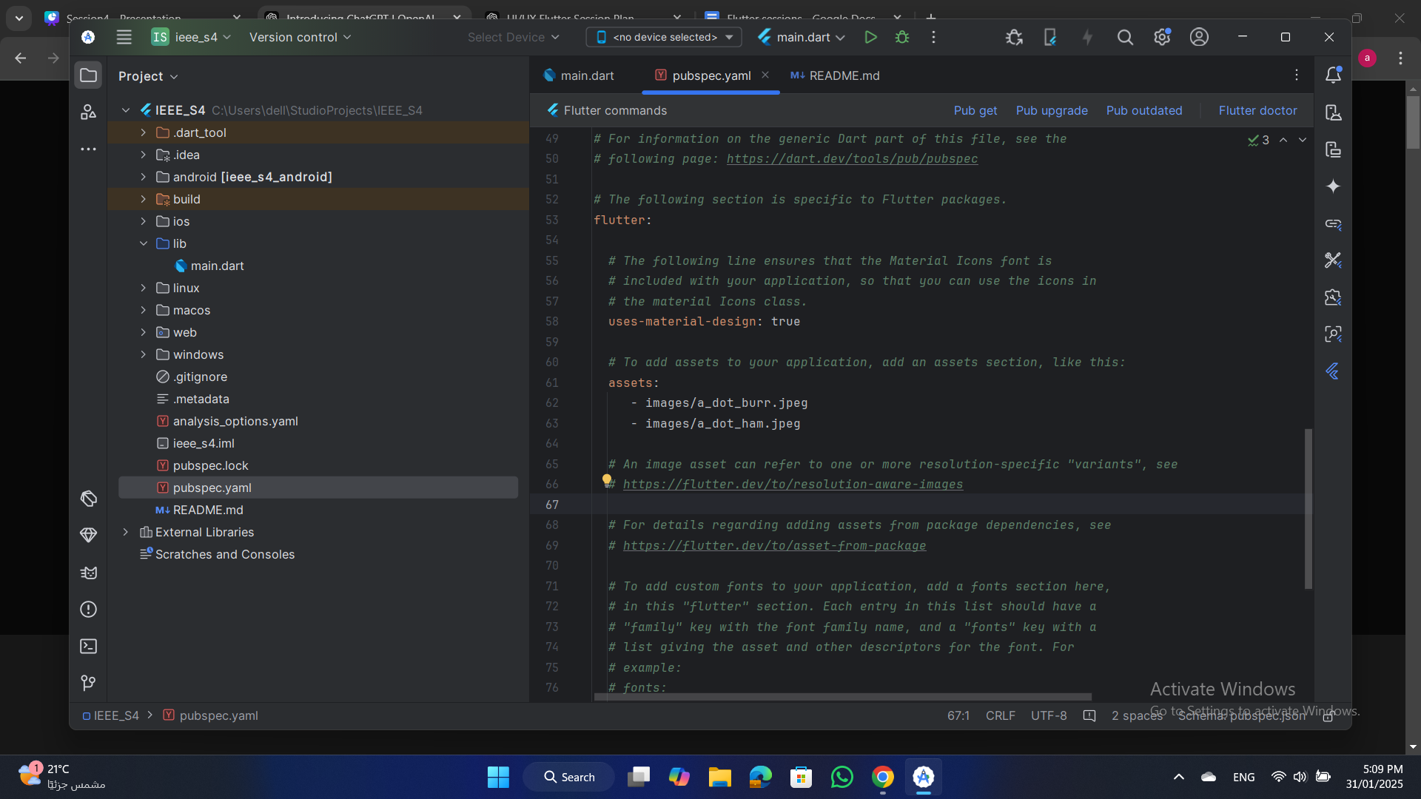
Intro to Flutter
3.assets/ (Images, Fonts, and Icons)
This folder stores local images, fonts, and other assets.
You need to declare them in pubspec.yaml
S25' Training Sessions

Slide 11
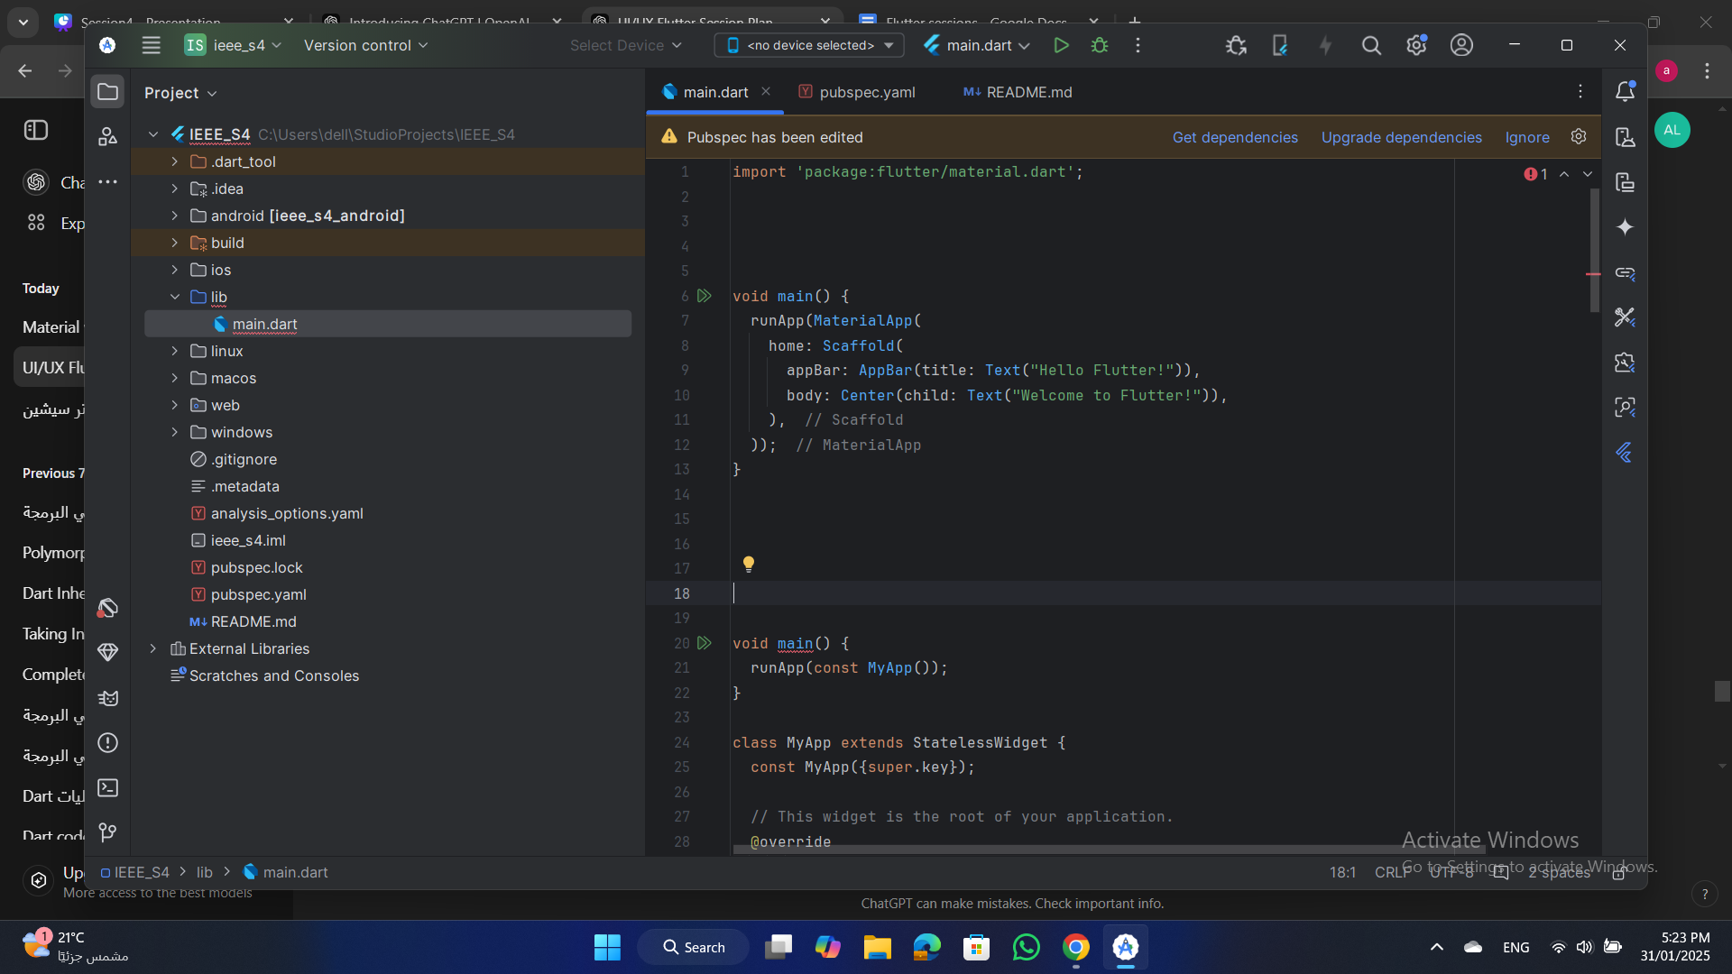
intro to widgets
1.runApp() : (The Starting Function)
This function launches the app by passing a widget (usually MaterialApp or CupertinoApp).
S25' Training Sessions

Slide 12
intro to widgets
2.Material vs. Cupertino (Android vs. iOS UI Design):
Flutter provides two main UI styles:
S25' Training Sessions
Material Design (Android Style)
Uses MaterialApp
Provides Google’s Material Design components (e.g., AppBar, FloatingActionButton, Snackbar).

Slide 13
intro to widgets
Cupertino (iOS Style)
Uses CupertinoApp
Provides iOS-style components (e.g., CupertinoButton, CupertinoNavigationBar).
S25' Training Sessions

Slide 14
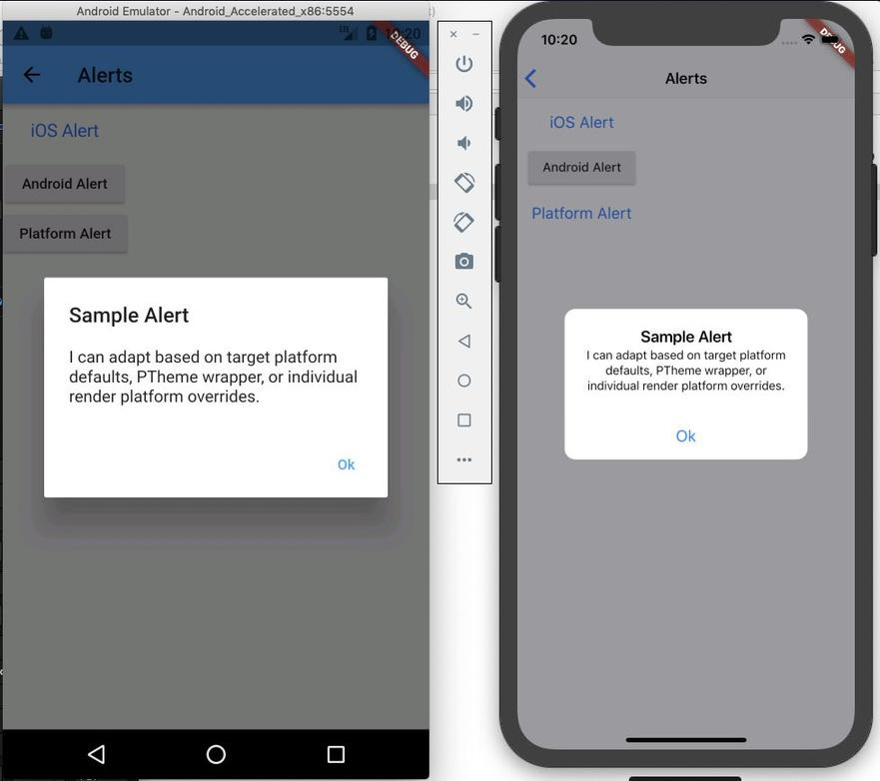
intro to widgets
Material vs. Cupertino
S25' Training Sessions

Slide 15
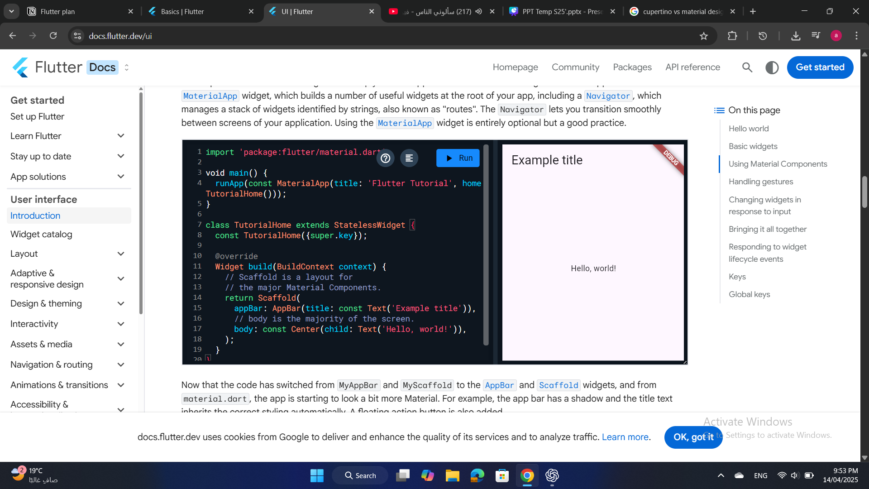
Layout Widgets
Scaffold Widget
Implements the basic Material Design visual layout structure.
S25' Training Sessions

Slide 16
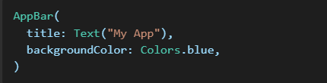
basic widgets
Appbar Widget
A top bar to display titles, buttons, and icons.
S25' Training Sessions

Slide 17
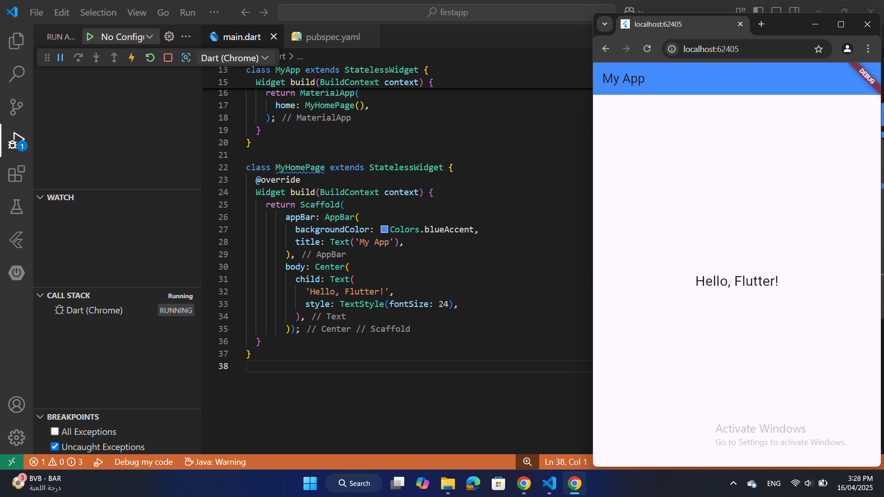
Layout Widgets
Center
S25' Training Sessions
Centers its child within itself both vertically and horizontally.

Slide 18
basic widgets
Text
Displays a string of text with single style.
S25' Training Sessions

Slide 19
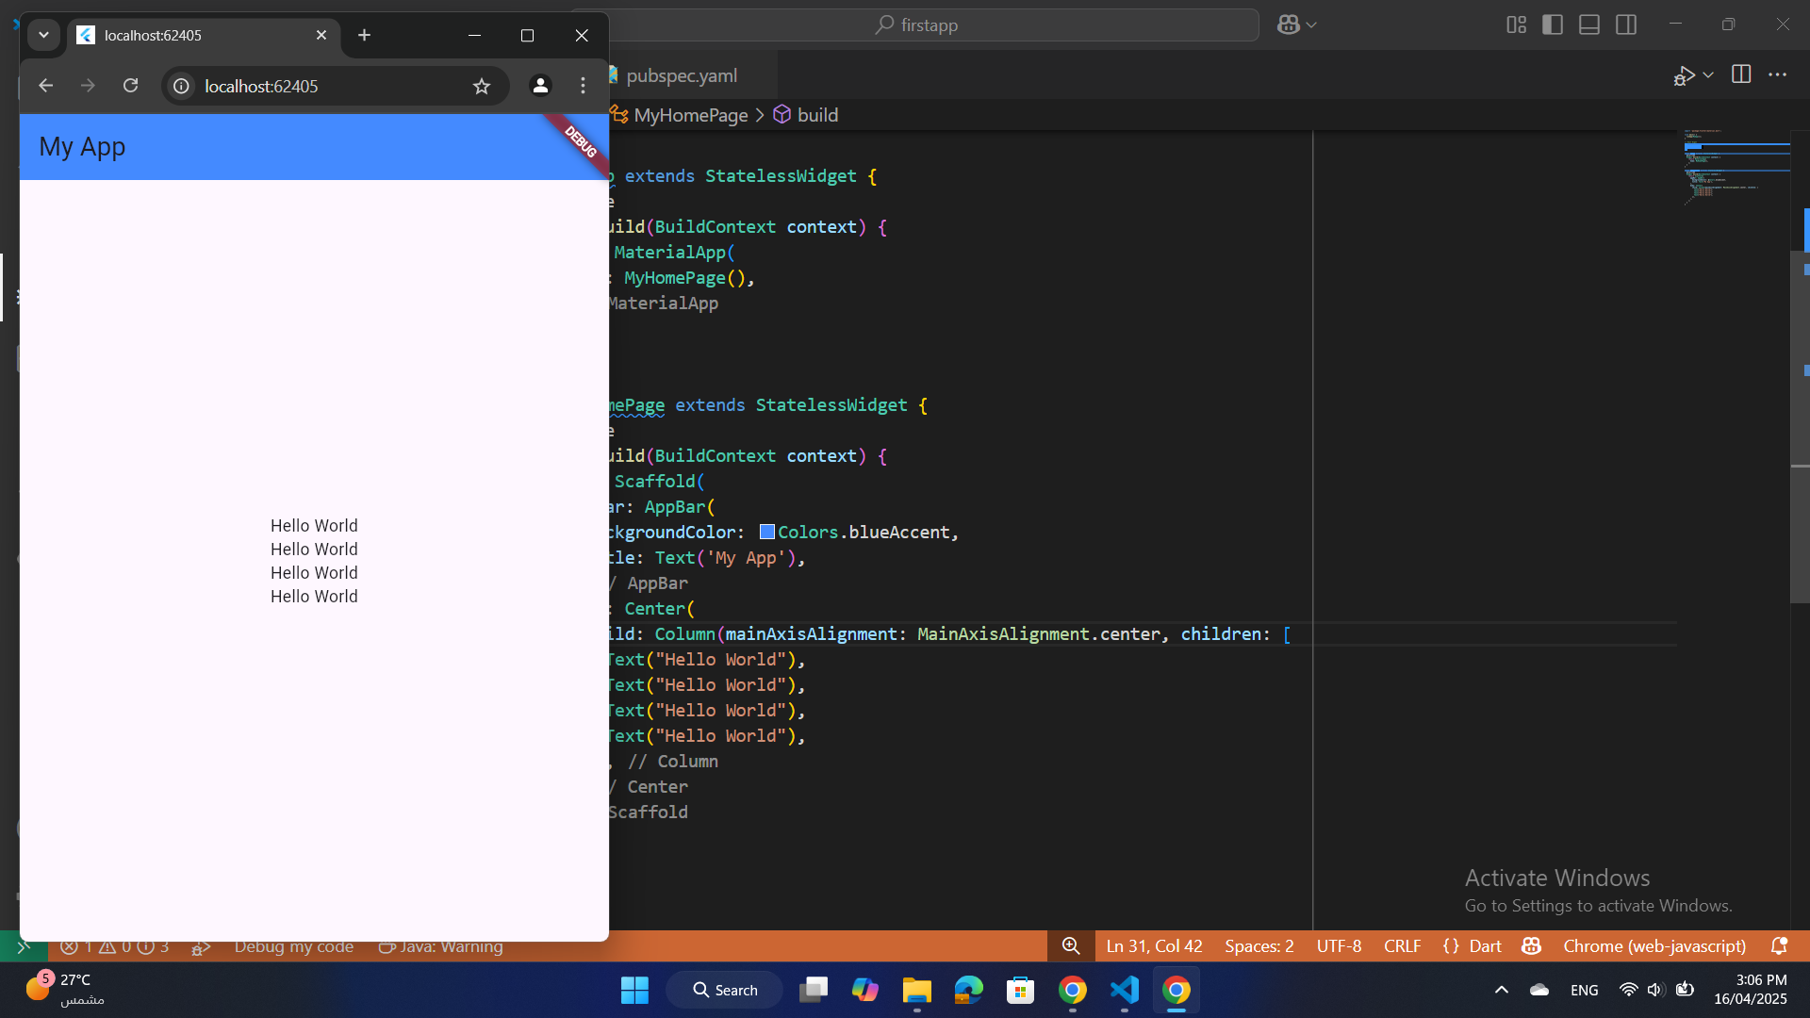
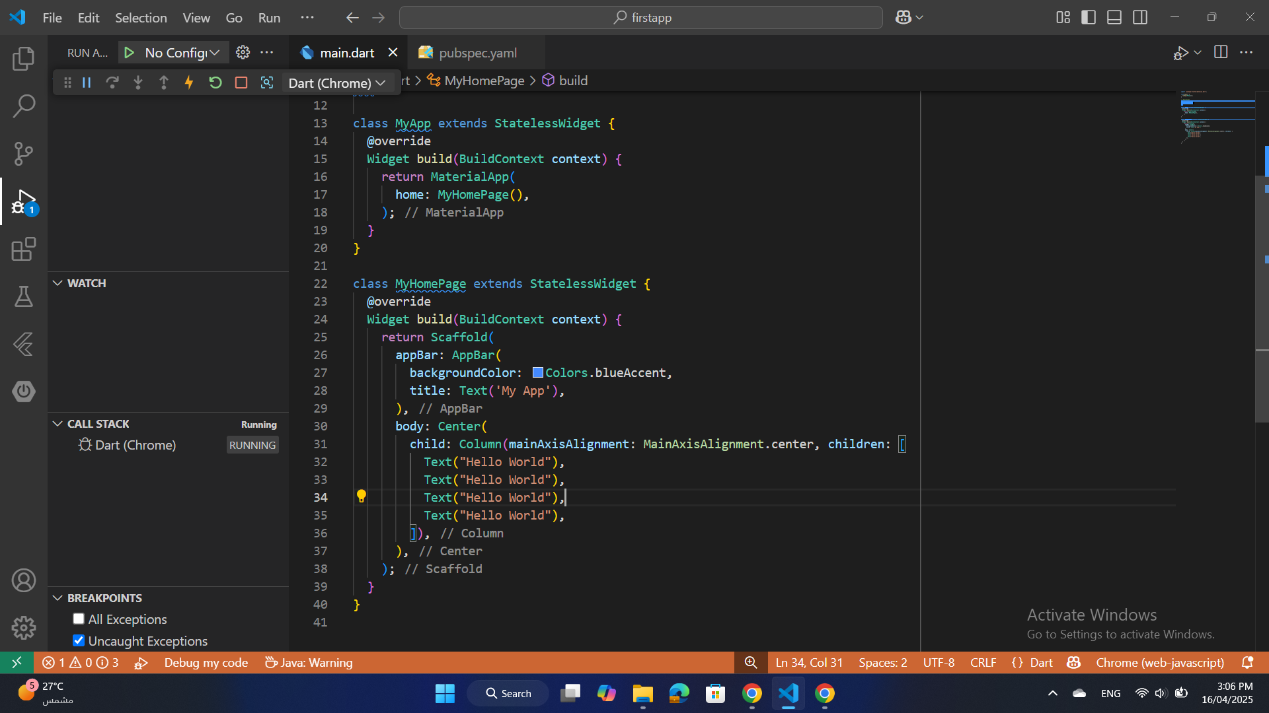
Layout Widgets
Column
Arranges widgets vertically
S25' Training Sessions

Slide 20
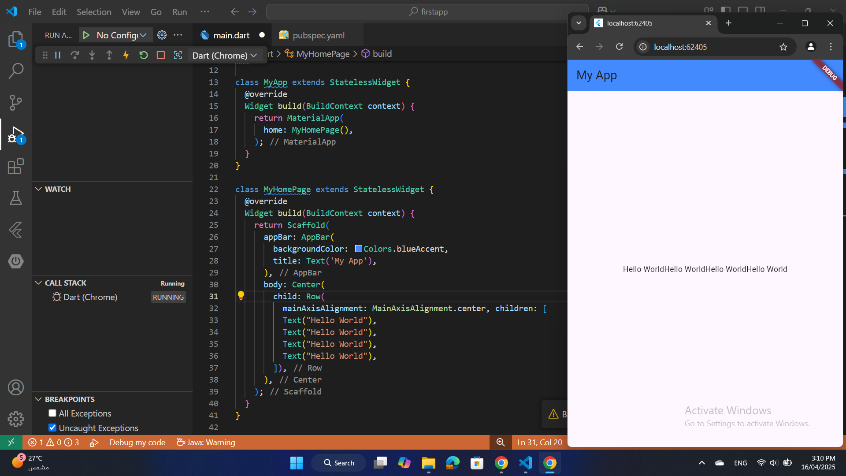
Layout Widgets
Row
S25' Training Sessions
Arranges widgets horizontally.

Slide 21
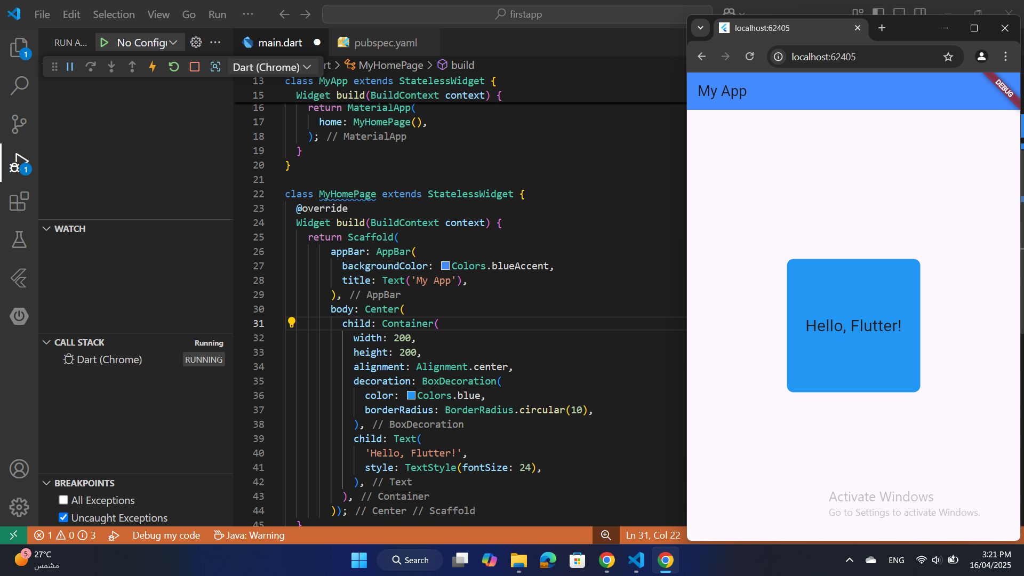
Layout Widgets
Container Widget
Used for layout and styling.
Example properties: padding, margin, decoration.
S25' Training Sessions

Slide 22
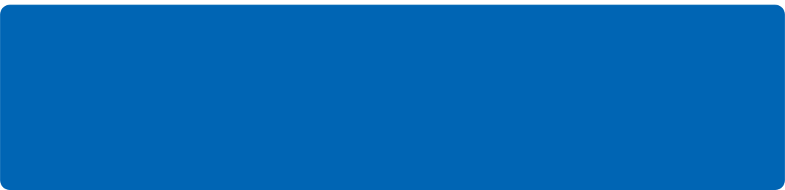
tHANK YOU
SEE YOU NEXT TIME
S25' Training Sessions

